Slide 1

2024
BIRD STRIKES ANALYSIS
Data visualization of bird strikes with the aircrafts from 2000-2011.
Date: 7th June 2024
Name ：Shaikh Minhazuddin

Slide 2
OBJECTIVE OF TASK.
DETAILS OF THE DATASET.
CONTENTS
VISUALIZATION & STORY TELLING
THANK YOU

Slide 3
01
OBJECTIVE
To analyze the Bird strikes with the aircrafts in the span of 11 years. We have to visualize the datasets and draw the insights from the data.
We have to make a dashboard where we can see the different parameters and measures like highlighted area, timeline etc

Slide 4

AIRCRAFT TYPE
LOCATION
PHASE OF FLIGHT
CLIMATE
The type of the aircraft helps in deciding which aircraft are more likely to affect with the strike.
Location helps in deciding the which are the areas are more affected by the bird strikes.
Phase of the flight decide the current condition of the flight at the time of bird strikes.
What is the climate conditions of the location at the time of strikes.
2. Details of the Datasets:-
It contains different type of parameters like airplane type, altitude, Location, No of people injured, Flight Model etc.
It contains around 25000 datasets with 26 different parameters which covers all the geographical area and flight zone.

Slide 5
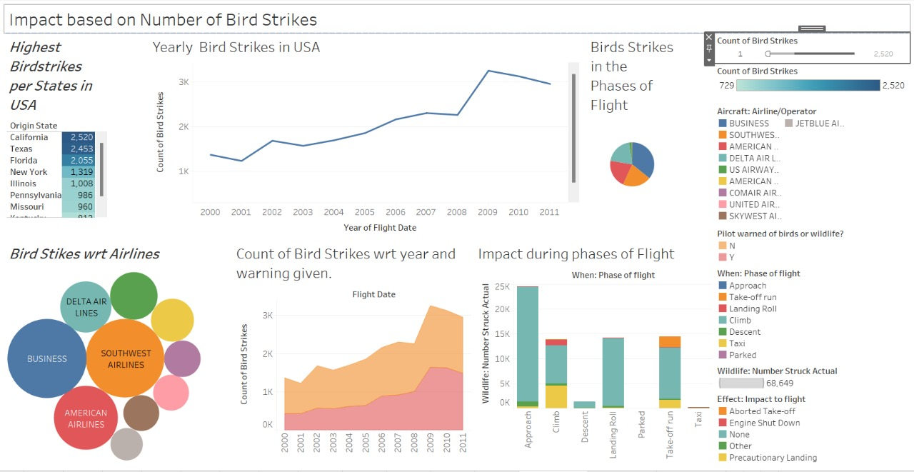
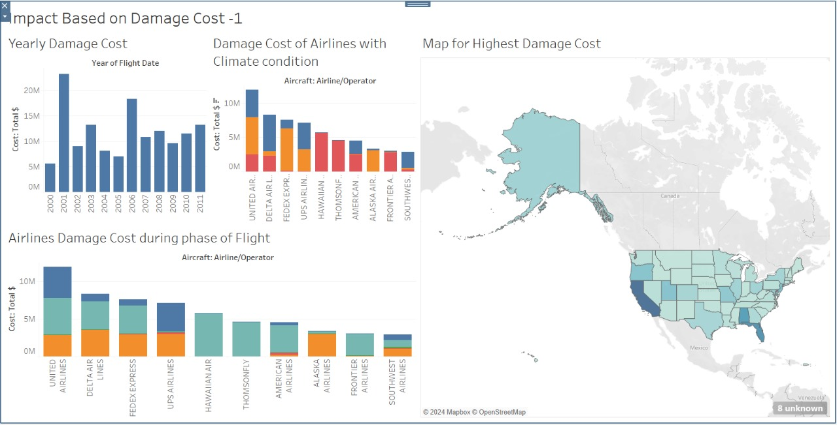
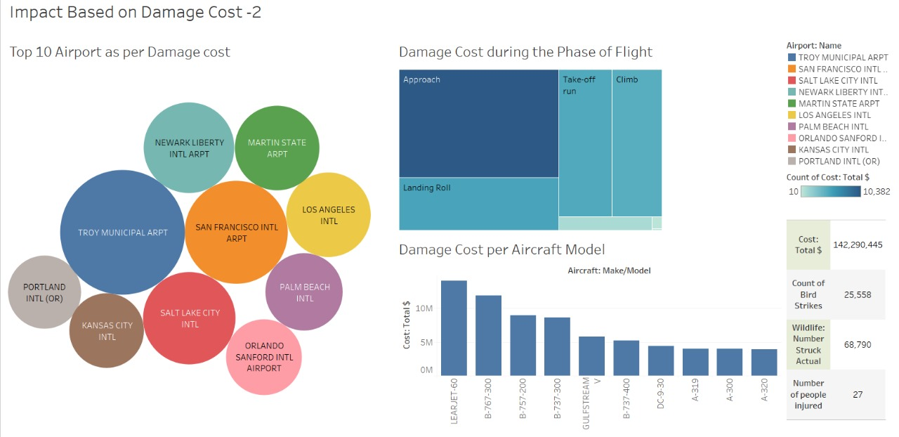
VISUALIZATION & DESIGN:-

Slide 6
THANK YOU
Date: 7 June 2024
Name: Shaikh Minhazuddin

